Slide 1
RIFFA 2.2.2 for dummy
2018/04/09 v1.0 Sheng Jui, Huang
2019/07/17 v2.0 Shih Wei, Hsieh
2021/07/30 v3.0 Yan Lun, Wu & Shu Fan, Wu
2022/08/12 v4.0 Shu Fan, Wu & Shih Hao, Huang
2023/08/17 v5.0 Ke Fan, Lin
2024/07/32 v5.1 Catfish, Yan
2025/02/31 v99.0 Jimmy, Shih

Slide 2
Outline
FPGA introduction
What is RIFFA
Practice
Other useful utilities

Slide 3
Outline
FPGA introduction
What is RIFFA
Practice
Other useful utilities

Slide 4
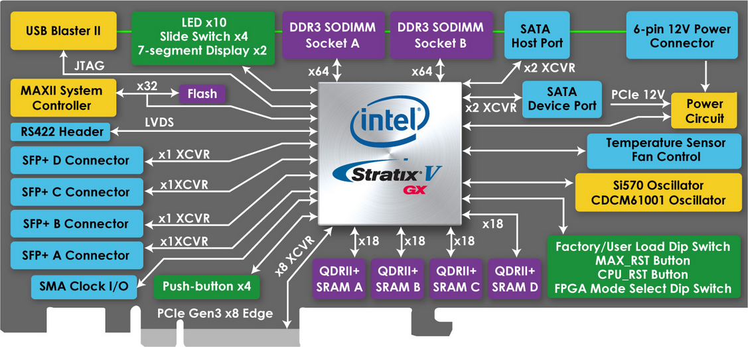
Terasic FPGA
DE5-Net FPGA Development Kit
https://www.terasic.com.tw/cgi-bin/page/archive.pl?Language=Taiwan&CategoryNo=159&No=726
Altera Stratix® V GX FPGA (5SGXEA7N2F45C2)
Lots of resources in the web, includes user manual and CD
10 LEDs / 4 push-buttons / 4 slide switches / 2 seven-segment displays
622,000 logic elements (LEs)
50-Mbits embedded memory
512 18-bit x 18-bit multipliers / 256 27-bit x 27-bit DSP blocks

Slide 5
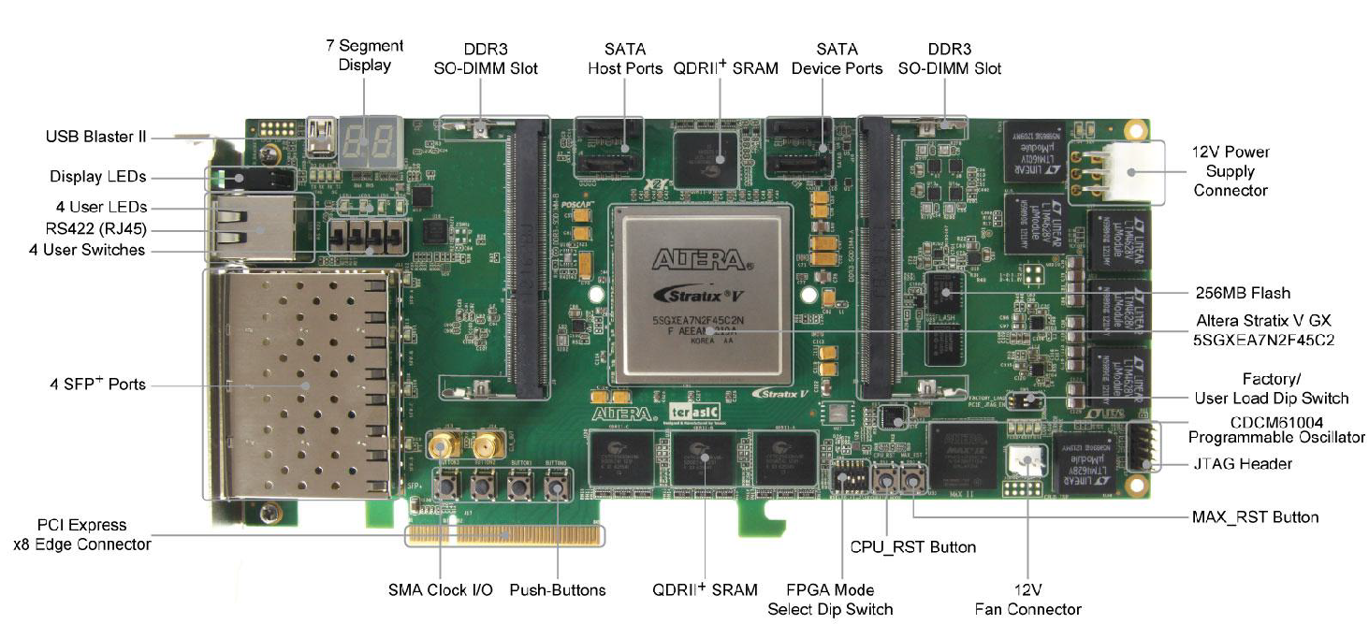
Terasic FPGA
PCIe
USB Blaster
12V Power Supply

Slide 6
Terasic FPGA
DE5a-Net FPGA Development Kit
https://www.terasic.com.tw/cgi-bin/page/archive.pl?Language=Taiwan&CategoryNo=229&No=1138
Arria 10 GX FPGA (10AX115N2F45E1SG)
Lots of resources in the web, includes user manual and CD
8 LEDs / 4 push-buttons / 2 slide switches / 2 seven-segment displays
1150K logic elements (LEs)
67Mbits embedded memory (50Mbits?)
3036 18-bit x 19-bit multipliers / 1518 Variable-precision DSP blocks

Slide 7
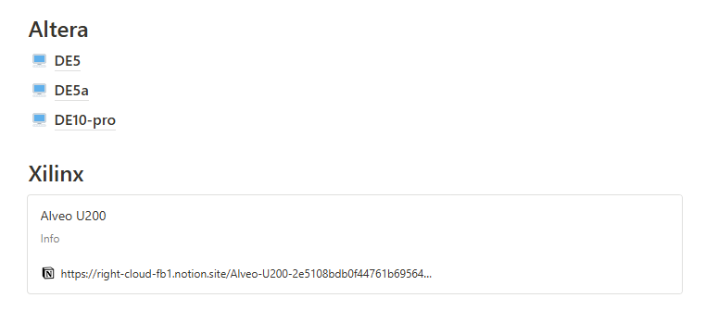
notion
https://bl430fpga.notion.site/bl430fpga/BL430-FPGA-bc15283eff644dbb99361cf0e3277a40

Slide 8
Server list
The resources in our lab
https://available-soursop-b6e.notion.site/Server-78a8b54198244cdca3d603d70ed0397c
若對server有問題的話可以詢問伺服器管理員:曾泓瑜學長與黃政勳學長

Slide 9
Outline
FPGA introduction
What is RIFFA
Practice
Other useful utilities

Slide 10
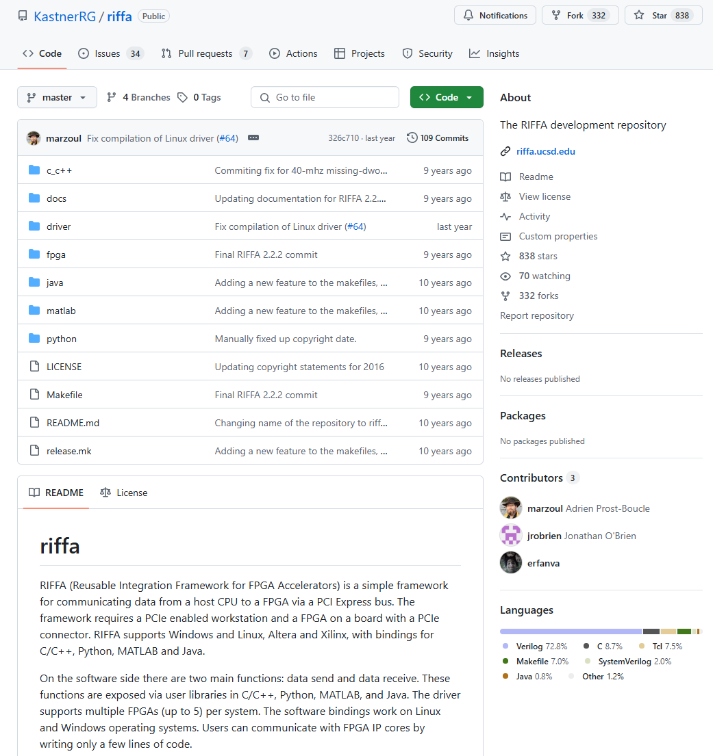
What is RIFFA

Slide 11
What is RIFFA
RIFFA:
Reusable Integration Framework for FPGA Accelerators
Requires a PCIe enabled workstation and a FPGA board with a PCIe connector
Pros:
Both the software and hardware interfaces have been greatly simplified
Ease of programming: details of the PCIe protocol, device driver, DMA operation, and all hardware addressing are hidden from both the software and hardware.
Support for Linux and Windows, software bindings for C/C++, Python, Matlab, and Java
Cons:
Takes up resource: If no high speed data I/O communication is needed, then its better to not use it
Loss of flexibility

Slide 12
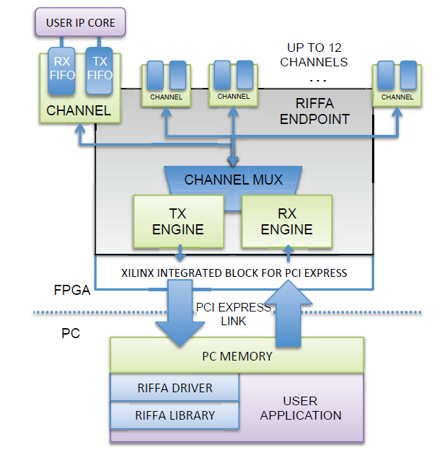
What is RIFFA
User cores interface with RIFFA 2.0 via a Channel core
The Channel core has FIFOs for receiving and sending data respectively.
The RX Engine core is responsible for extracting and demultiplexing received PCIe payload data.
The TX Engine core is responsible for formatting payload data into PCIe packets and multiplexing access to the PCIe link
The PCIe link configuration determines the width of the data bus. This width can be 32, 64, or 128 bits wide (RIFFA does not support 256 bits interface)
All PCIe Gen 1 and Gen 2 configurations up to x8 lanes are supported.
Where you need to plug your design

Slide 13
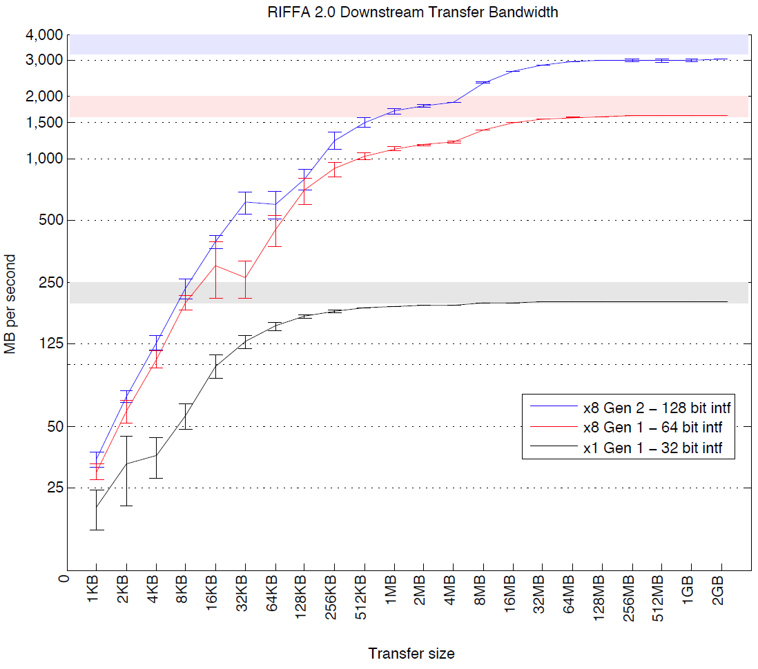
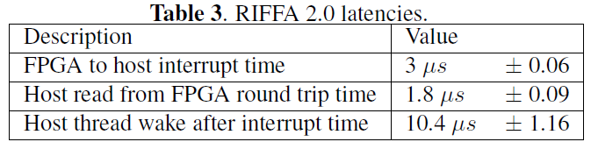
What is RIFFA
Sending data in smaller transfer sizes reduces effective throughput
Making a copy of a large buffer of data in software before sending it to the FPGA takes time and can severely impact throughput
Less transmission improves throughput
綜合前幾頁所述，簡而言之，riffa就是一個已經寫好PCIE/FPGA driver和driver該互動的Verilog files的開源框架。

Slide 14
RIFFA
RIFFA package
documentation
source
c_c++
linux
x64
sample_apps → Our input file from c code
fpga
riffa_hdl → all submodules in riffa → You should place all your rtl code here
altera → Choose Our board (DE2i / DE4我們不用)
de5 / de5a → Different board
DE5QGen*x*If128 / DE5QGen*x*If128_CLK → Different PCIe choice or CLK
Bit → The compilation file after synthesized (.sof file)
Constr → sdc file for FPGA
→ Modify by your own usage(例如你要調clk period)
Hdl → Top module file
ip → qsys file
prj
.qpf → Quartus project file → used in save project / open project
.qsf → Quartus setting file→ File setting and compilation board setting

Slide 15
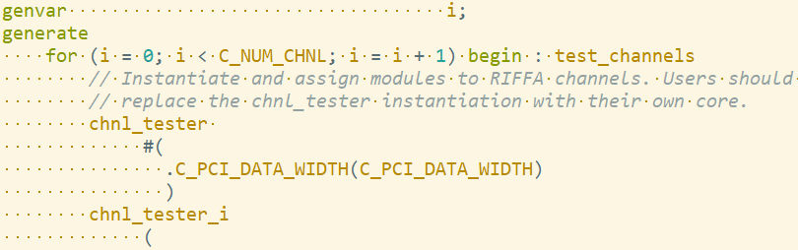
Top module file
 | DE5QGen2x8IF128.v | DE5QGen2x8IF128_CLK.v
C_PCI_DATA_WIDTH | 128 | 128
Qsys | QSysDE5QGen2x8If128 | QSysDE5QGen2x8If128_CLK
riffa_wrapper_de5 | At de5 folder | At de5 folder
chnl_tester | # of core parallel | different frequency
reference clk | chnl_clk | riffa_*_clk
Please check Appendix 3, too

Slide 16
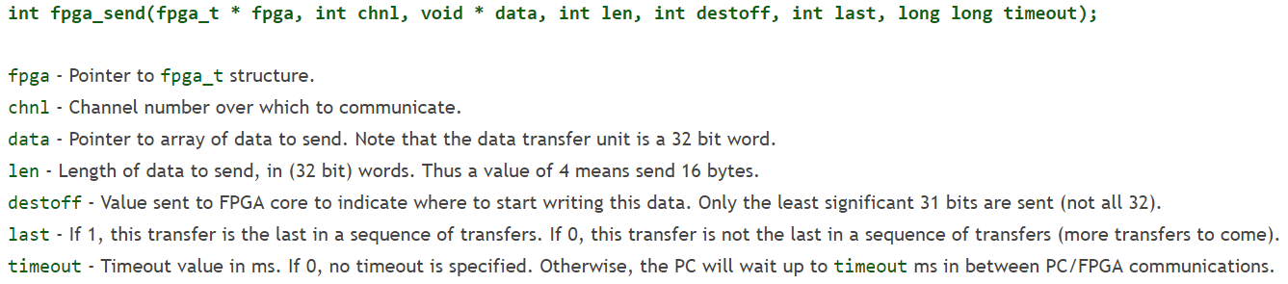
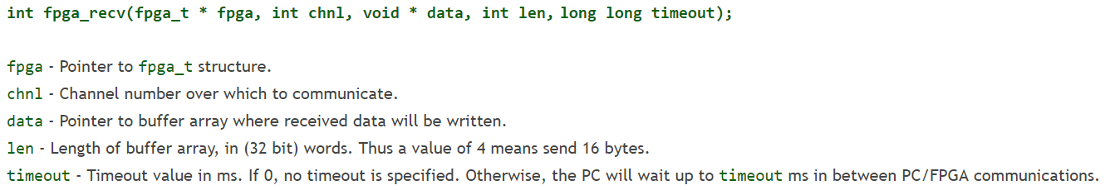
Software Interface
RX/ TX protocol:
Learn from example: our sample code

Slide 17
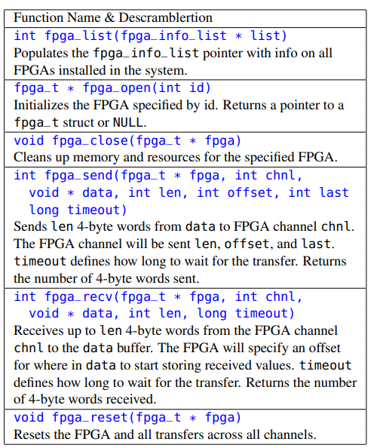
Software Interface
RX/ TX protocol:

Slide 18
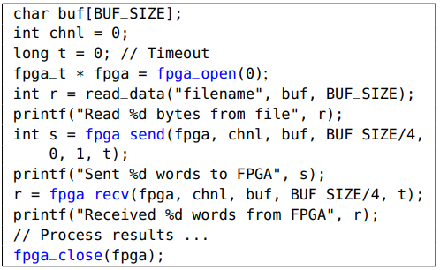
Sample usage
建議要以int宣告避免不必要的bug出現

Slide 19
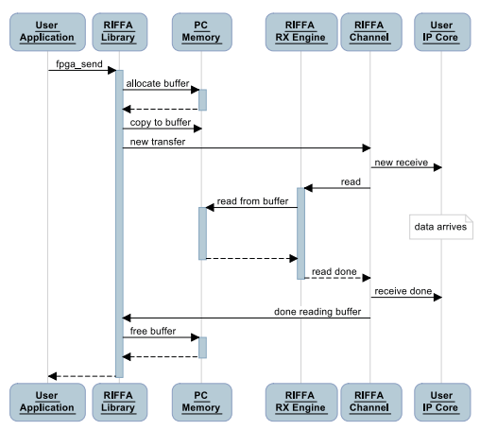
Full transmission – send

Slide 20
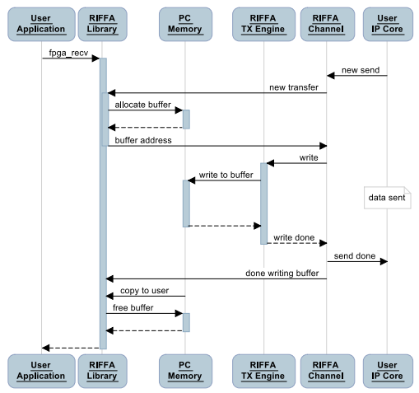
Full transmission – receive

Slide 21
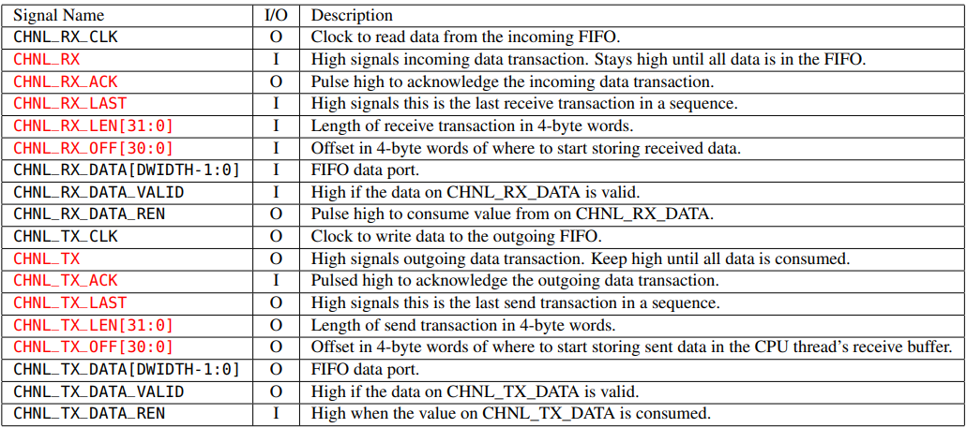
TX RX protocol ports

Slide 22
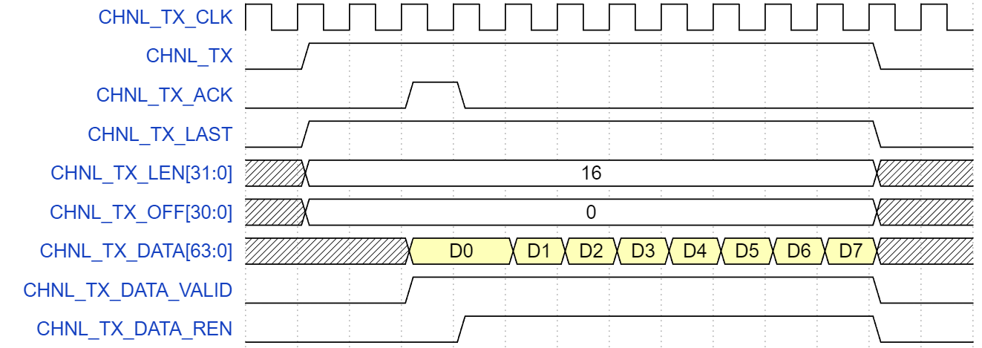
TX protocol basic
CHNL_TX_LEN: Total data size in “word [32bit]”
CHNL_TX_DATA: (128 bit): Transmitted data
CHNL_TX_DATA_VALID: Pull high when CHNL_TX_DATA is valid
CHNL_TX_DATA_REN: Whether C++ is receiving this data or not
Pay attention:
VALID will not always be high !!!
Make FPGA’s chnl_tester send next data only if VALID and REN are high simultaneously, else keep sending the same data.
Driver: FPGA
Driver: C++
Driver: FPGA
Driver: FPGA
Driver: FPGA
Driver: FPGA
Driver: FPGA
Driver: C++
22

Slide 23
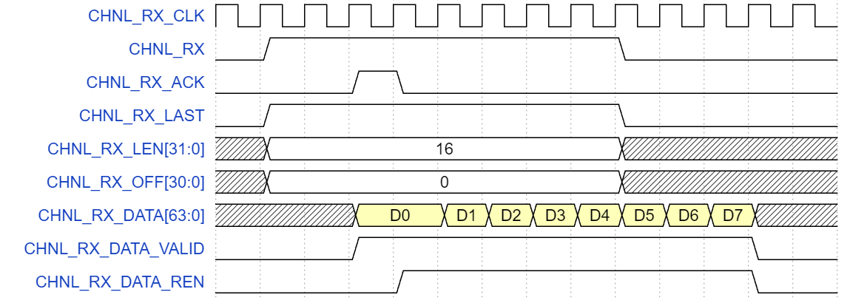
RX protocol basic
CHNL_RX_ACK: Need to be high for at least one cycle
CHNL_RX_LEN: Total data size in “word [32bit]”
CHNL_RX_DATA(128 bit): Transmitted data
CHNL_RX_DATA_VALID: Whether CHNL_RX_DATA is valid
CHNL_RX_DATA_REN: Control C++ to transmit next data or not
Pay attention:
VALID will not always be high !!!
RX will send next data only if VALID and REN are high simultaneously, else it will keep sending the same data.
Driver: C++
Driver: FPGA
Driver: C++
Driver: C++
Driver: C++
Driver: C++
Driver: C++
Driver: FPGA

Slide 24
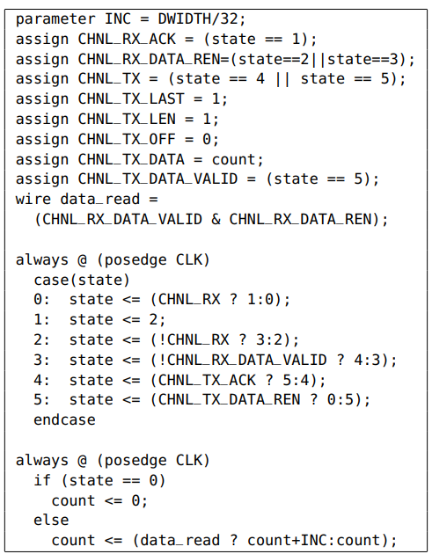
Sample usage
In this example, the user core receives data from the software thread, counts the number 4-byte words received, and then returns the count.

Slide 25
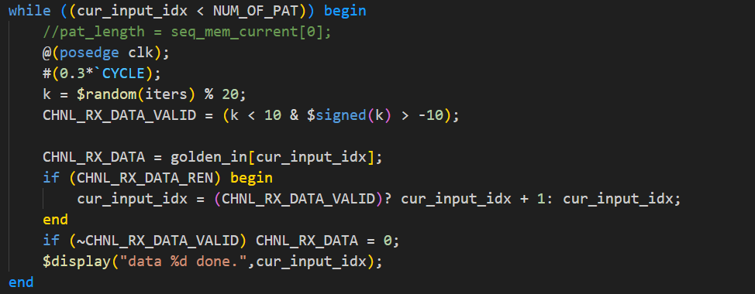
tb_chnl_tester.v -> RX
建議從雲端中下載tb檔案來修改 (credit: 黃士豪 學長)
testbench中有模擬RIFFA TX傳輸行為，cur_input_idx為目前正在傳輸第幾個data，在符合條件時使idx增加
通常需要修改的是在第幾筆data時需要傳輸什麼，也就是data transaction part
Data transaction part
Protocol part

Slide 26
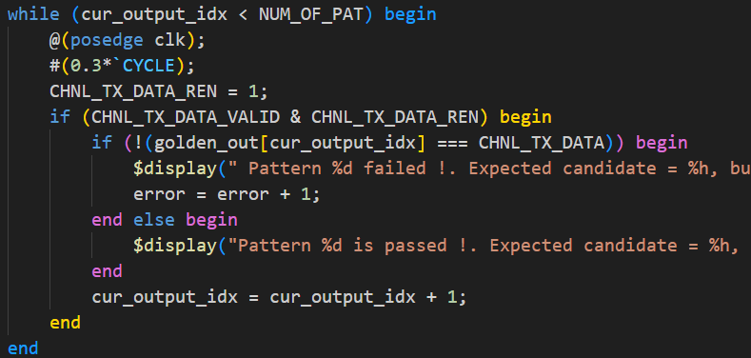
tb_chnl_tester.v -> TX
testbench中有模擬RIFFA TX傳輸行為
在符合條件時接收資料，並讓cur_output_idx 增加
把CHNL_TX_DATA的資料跟golden比較
Protocol part
Data transaction part
極度建議用RTL模擬完chnl_tester再上板測試
珍惜生命，盡量不要以燒板子的方式debug

Slide 27
Some hints
RX/TX 可以同時進行傳輸，也就是RX在傳輸的同時讓chn_tester中的CHNL_TX訊號也拉高來進行傳輸，但要注意REN,VALID等訊號的控制要寫好。
RX/TX 可以交互進行傳輸，利用RX_REN來使RX傳輸暫停，或使用TX_VALID訊號來使TX傳輸暫停，來控制在特定情況時要使用TX還是RX方向的傳輸。
善用tb_chnl_tester或signal_tap來檢查RIFFA interface有哪裡是沒有處理好的。

Slide 28
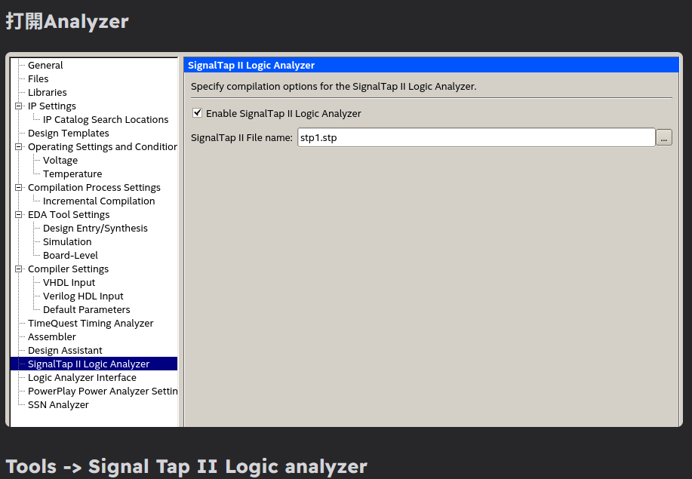
Signal Tap
https://hackmd.io/@VdgkdLfjTJqoAqqkM8zAvA/rk10ItfPR
有使用上問題的話可以google直接搜尋關鍵字

Slide 29

Adventure time
Website
RIFFA original paper:
http://kastner.ucsd.edu/wp-content/uploads/2014/04/admin/fpl-riffa2.pdf
Github:
https://github.com/KastnerRG/riffa
這些網站裡可能有意想不到的寶藏

Slide 30
Outline
FPGA introduction
What is RIFFA
Practice
Other useful utilities

Slide 31
Recommended design flow
It is recommended that you separate your design from the RIFFA transmission part
Use testbench to complete and debug your design.
Put your design into RIFFA channel (chnl_tester.v)
Use testbench to complete RIFFA channel with your design concluded
Complete C++ interface , print and check pattern from C++ interface
Compile and test on FPGA -> d(`･∀･)b
ASIC flow
FPGA flow
RIFFA Channel
Your design
RIFFA C++ interface
Print pattern
pattern generator
Testbench for
design
Testbench for
chnl_tester.v
Should be same pattern

Slide 32
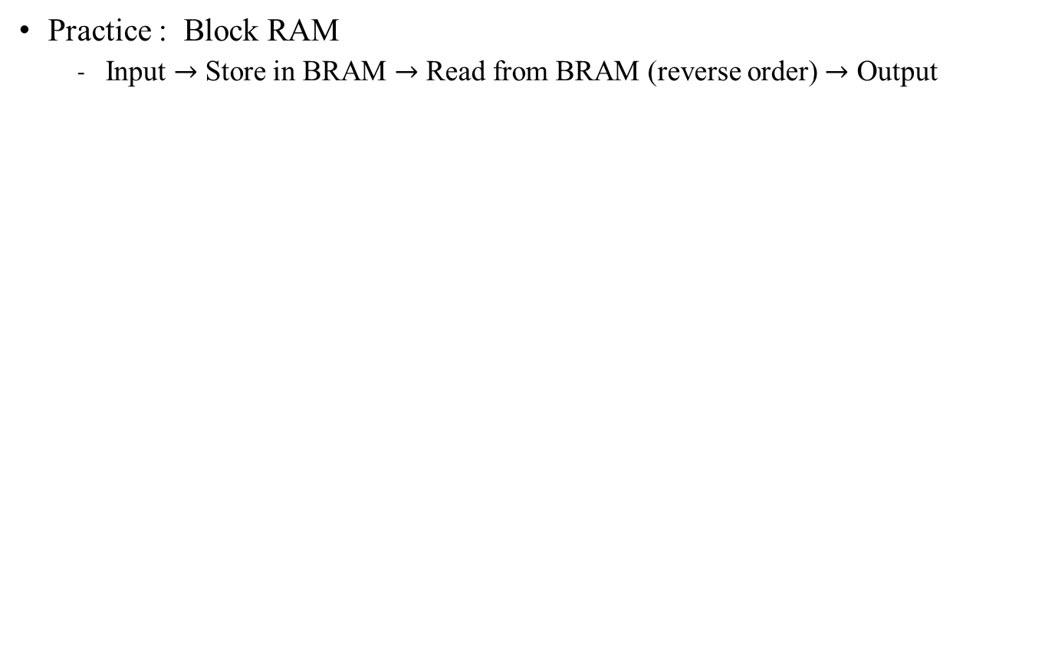
Practice time
Data input
Block RAM
Decreasing
Addr
Increasing
Addr
Data output

Slide 33
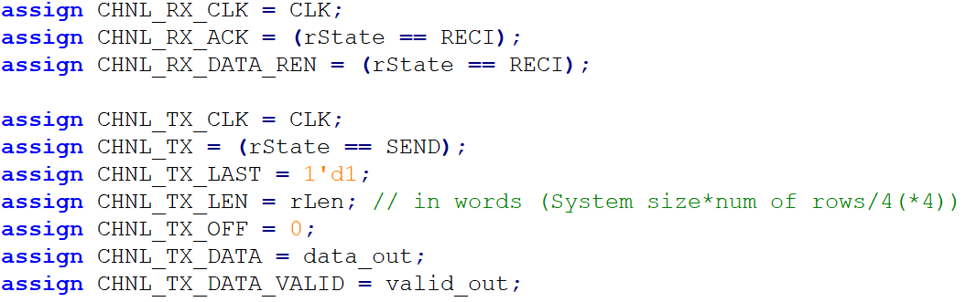
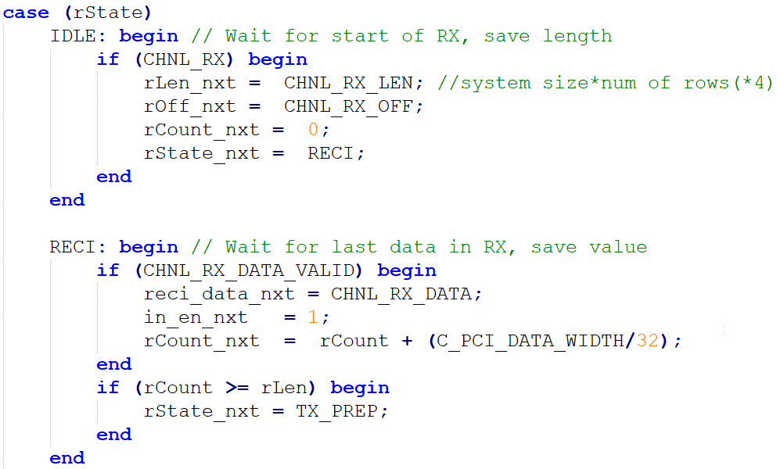
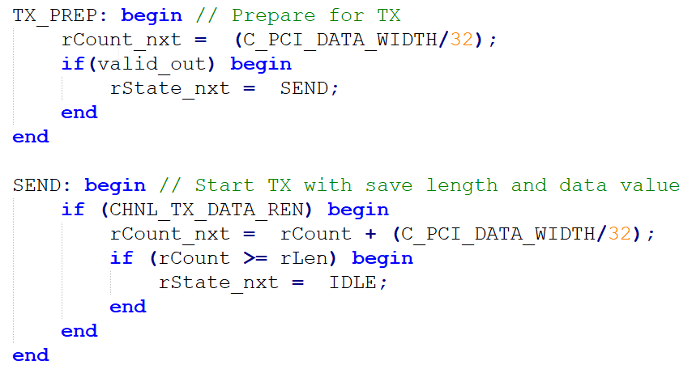
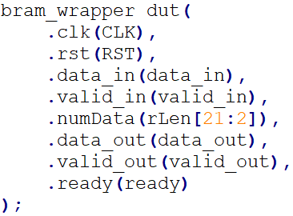
Practice time
Channel tester:
Plugged design

Slide 34
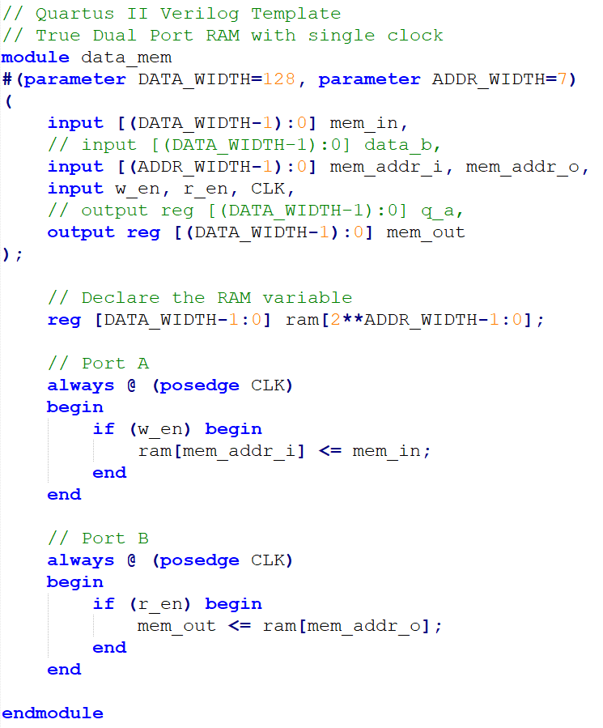
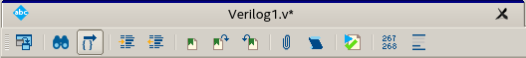
Practice time
Inferred dual port Block RAM:
Tips
Generate template memory file
Quartus → File → New file → Verilog HDL file
Insert template
Verilog HDL
There are lots of template to use
Select the RAM by your own

Slide 35
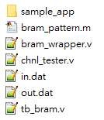
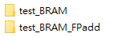
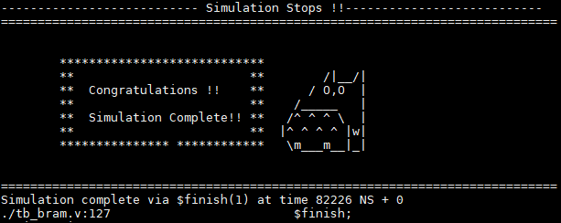
Step-by-step guide - RTL simulation
1. Download sample code:
2. Generate pattern from bram_wrapper.m (done)
3. Check design
Only need bram_wrapper.v in.dat out.dat tb_bram.v for simulation
Source file: source /cad/source.cshrc
For design: ncverilog tb_bram.v bram_wrapper.v +access+r
For RIFFA + design: source test_chnl
Practice 1

Slide 36
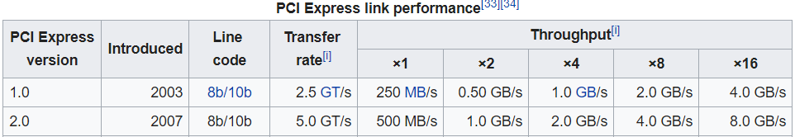
Step-by-step guide - FPGA simulation
Open Quartus II (License file: 25000@140.112.33.164)
Quartus 17.0:
/mnt/ds1515/opt/intelFPGA/17.0/quartus/bin/quartus &
Copy RIFFA from workstation
cp -r /mnt/ds1515/fpga/riffa_2.2.2/ ./
Open Project
Located at:
<your path>/riffa_2.2.2/source/fpga/altera/de5/DE#Gen#x#If###/prj/DE#Gen#x#lf###.qpf
DE#Gen#x#If###: we use DE5Gen2x8If128
Our FPGA: DE5
PCIe Spec: generation 2; 8 lanes; 128 bits width (250 MHz)
你也可以選擇不同版本的 Gen，RIFFA 支援多個 PCIe Gen 版本，但請確認你的主機板支援 PCIe x8 介面，通常大多數 PCIe 2x8（Gen2 x8）配置的主機板都可以支援
Gen2x8 | 250 MHz/ 128 bits
Gen2x4 | 125 MHz/ 128 bits

Slide 37
Step-by-step guide
4-1. Copy files from <WORKDIR>/test_BRAM/ to RIFFA directory:
<your path>/riffa_2.2.2/source/c_c++/linux/x64/
<your path>/riffa_2.2.2/source/fpga/riffa_hdl/
須先把sample_app裡面原有的資料全部刪除

Slide 38
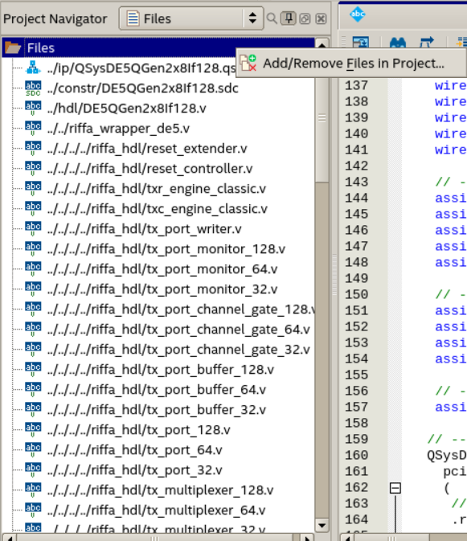
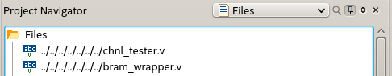
Step-by-step guide
4-2. If not added, use project navigator in quartus
Project Navigator
→ Files
→ add/remove files in Project (右鍵Files)
加入你的bram_wrapper (your design) 和你的 chnl_tester.v
(所有你的verilog檔案)

Slide 39
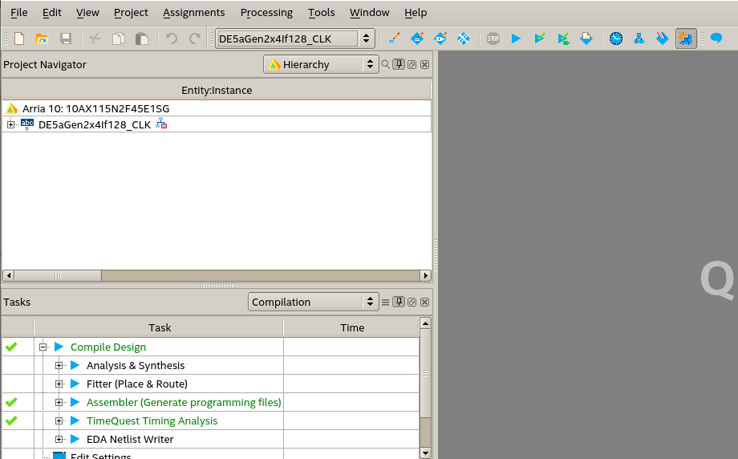
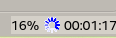
Step-by-step guide
Compile:
(before compilation, Quartus will autosave your current process →.qpf file)
(may take some time)
等右下角的進度顯示為100%
Press

Slide 40
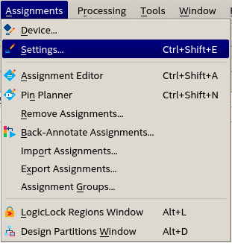
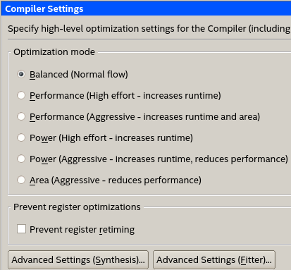
Step-by-step guide
Additional settings (Supplement)
You can select different compiler settings for better compilation
In advanced setting, synthesis or fitter can make different result
In .qsf file, you can make these setting by command.
Ex. 16 parallel compilier setting
set_global_assignment -name NUM_PARALLEL_PROCESSORS ALL
qsf file is very important~

Slide 41
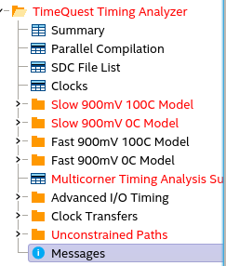
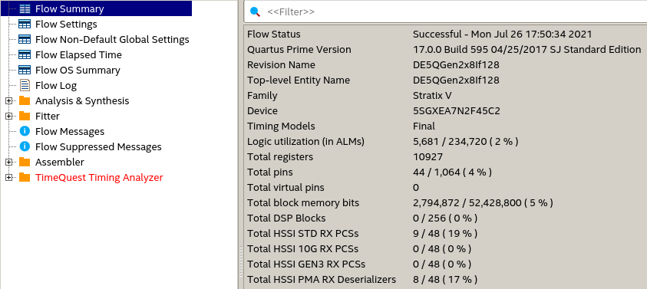
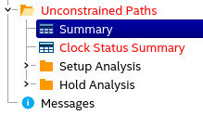
Step-by-step guide
請確保fast corner一定要過
Pay attention to these
Compilation report
Ignore this for now

Slide 42
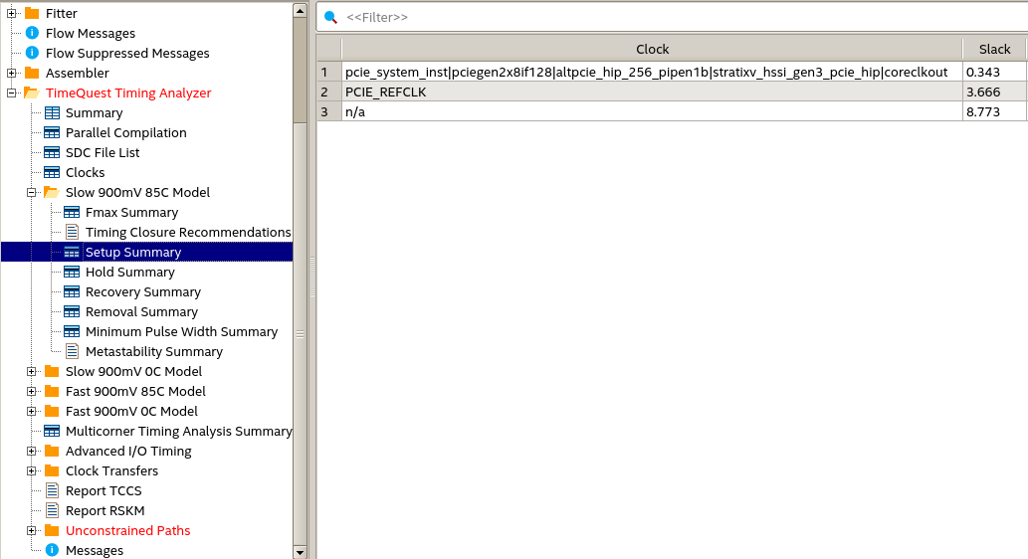
Step-by-step guide
Timing analyzer
WNS should be positive for all corners
Not ok, but we’ll skip for now

Slide 43
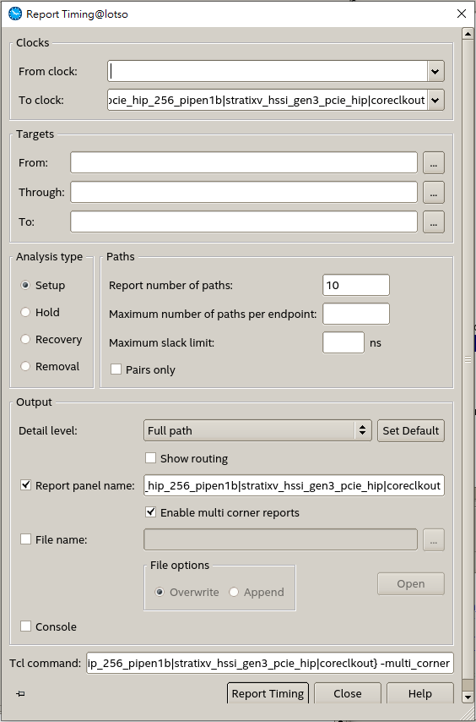
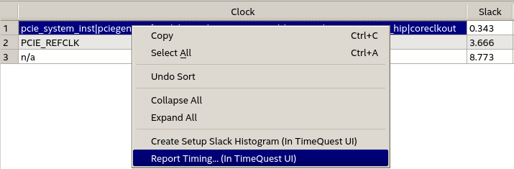
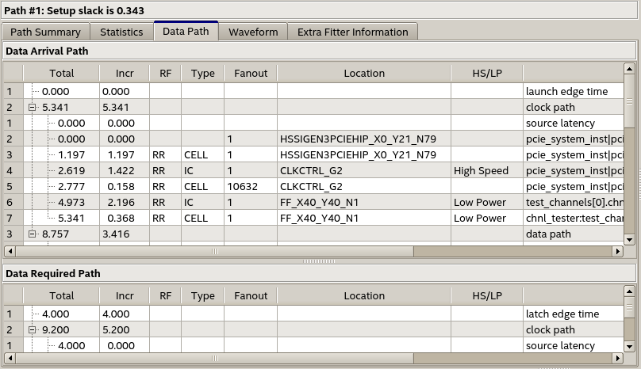
Step-by-step guide
Timequest timing analyzer
此工具可找到
Critical path

Slide 44
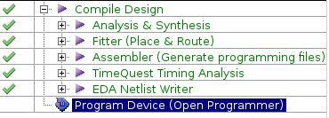
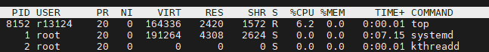
Step-by-step guide
Programmer
After finish compilation
cd <your path>/riffa_2.2.2/source/fpga/altera/de5/DE#Gen#x#If###/bit/
Run: /mnt/ds1515/opt/intelFPGA/17.0/quartus/bin/jtagconfig
這邊只有一個板子DE5 standard，所以c=1，如果發現有其他板子，看你要用哪塊，c就設定那個(但c=1會最快，因為離CPU最近)
Run: /mnt/ds1515/opt/intelFPGA/17.0/quartus/bin/quartus_pgm -m jtag -c 1 -o “p;DE5QGen2x8If128.sof ” (ppt格式關係，如複製指令貼上，””括號請重打)
After you compiled, DE#Gen#x#If###.sof under /bit/ folder will be updated
這個指令會把電路燒上板子， “p;DE#Gen#x#If###.sof ” 長得很奇怪但沒錯
下次想再重燒重跑只要有這個檔案就可了，不用再開Quartus
- Run: sudo reboot → soft reboot讓server的OS可以看到fpga的PCIe driver
Don’t close the machine while others are compiling!
Use “top” to check other users’ usage

Slide 45
Step-by-step guide
Run
cd <your path>/riffa_2.2.2/source/c_c++/linux/x64/sample_app
make
./testutil 0 //List FPGA info
./testutil 1 0 //Reset FPGA 0
./testutil 2 <numofdata> //numofdata: must be multiples of 4 in this lab
You can check bram_wrapper.v for the reason

Slide 46
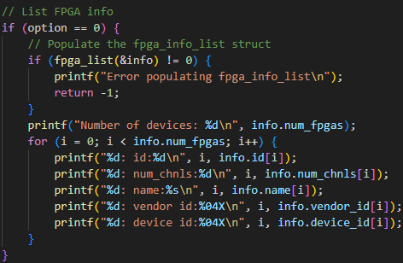
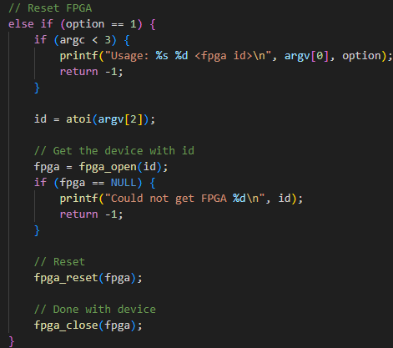
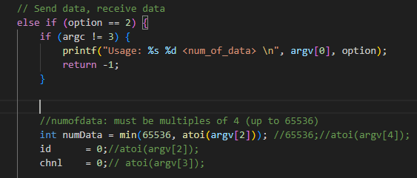
Step-by-step guide
Run

Slide 47


Step-by-step guide
Run -- remember to change your files here ( check testutil.cpp)
make
./testutil 2 <numofdata> //numofdata: must be multiples of 4
(up to 65536 due to the size of bram defined in bram_wrapper.v)

Slide 48
Step-by-step guide
只需修改input_memory與需傳輸的data大小
Input_memory與receive memory皆為int (32bit)的memory matrix，與TX/RX的128bit對應關係為:
TX/RX[n] = {mem[4n+3],mem[4n+2],mem[4n+1],mem[4n]}
生成memory時建議以INT型別來操作

Slide 49



Step-by-step guide
Run
其實可以自己調整你PCIe一次想傳輸的bits量，32/64/128。(預設128 bits，你真的想改請參考appendix 1)
但記得在testutil.cpp裡面，你的input_memory/output_memory/golden_output，都是以一個INT為單位。 如果你使用64/128 bits，RIFFA會自己幫你收集幾個INT(32 bits)再丟給你。

Slide 50

TODOs
Follow the previous step-by-step guide to finish the FPGA part
If you see this, you passed the FPGA test.
Screenshot !

Slide 51
DRAM tutorial
External Memory Interface IP
Avalon Memory-Mapped Protocol
Example Code
Quartus Project Settings
RTL Simulation with Qsys IP
Extension

Slide 52
External Memory Interface IP
Arria 10 External Memory Interfaces (EMIF)
這個IP可以將我們用Avalon Memory-Mapped介面傳輸的資料轉換為以DRAM介面傳輸的資料。
由於DRAM控制較複雜，有這個IP我們就能更方便的存取DRAM中的資料。
除了DRAM之外，這個IP也能改成與其他種類的外部記憶體溝通。 Ex. QDRII+ SRAM
External Memory
Arria 10 EMIF
Avalon Memory-Mapped Protocol
User Logic
DRAM Protocol

Slide 53
Avalon Memory-Mapped Protocol
The Avalon Memory-Mapped interface specification is designed to accommodate peripheral development for the system-on-a-programmable-chip (SOPC) environment.
The specification provides peripheral designers with a basis for describing the address-based read/write interface found on master and slave peripherals.

Slide 54


Slide 55
Avalon MM Basic Signals
Signal Type | Width | Direction | Description
address | 1-32 | M -> S | Slave address.
read | 1 | M -> S | Read-request signal to the slave port.
readdata | 1-1024 | S -> M | Data transferred from slave to master by the read operation.
write | 1 | M -> S | Write-request signal to the slave port.
writedata | 1-1024 | M -> S | Data transferred from master to slave by the write operation.
waitrequest | 1 | S -> M | Used to stall the system interconnect fabric when the slave port is not able to respond immediately.
readdatavalid | 1 | S => M | Marks the rising clock edge when the slave asserts valid readdata.

Slide 56
Avalon MM Slave Transfer Types
Variable Latency
Fixed Latency
Pipelined Variable Latency
Pipelined Fixed Latency
Tristate
Burst
More Info:
http://www1.cs.columbia.edu/~sedwards/classes/2009/4840/mnl_avalon_spec.pdf
http://www.innovateasia.com/asia/download/document/knowledge_11_Taiwan.pdf

Slide 57

Avalon MM Basic Waveform
readdatavalid

Slide 58

Basic Avalon MM Operation in the example
Write:
與SRAM操作類似。將write拉高並設定好address和writedata。但是當waitrequest訊號為1時，write、writedata、address必須保持為固定值。

Slide 59

Basic Avalon MM Operation in the Example
Read:
與SRAM操作類似。將read拉高並設定好address。但是當waitrequest訊號為1時，read、address必須保持為固定值。當readdatavalid訊號為1時，表示此時的readdata為有效值。

Slide 60
DRAM tutorial
External Memory Interface IP
Avalon Memory-Mapped Protocol
Example Code
Quartus Project Settings
RTL Simulation with Qsys IP
Extension

Slide 61
Example Code
Platform: DE5a-Net (with Arria 10 FPGA)
PCIe: Gen2x8 (250 MHz, 128 bit)
Lab Workstation: (Winnie)
IP: 140.112.48.159
Port: 40720

Slide 62
Example Code
Data Flow:
Input
-> Store in BRAM (A)
-> Read from (A), Store in DDR4
-> Read from DDR4, Store in BRAM (B) (reversed order)
-> Read from (B)
-> Output
PCIe
On-Chip
Block-RAM
(A)
Off-Chip
DDR4
On-Chip
Block-RAM
(B)

Slide 63
Example Code
由於DE5a板子上DDR4記憶體的寬度為64bit，而PCIe每個週期傳輸128bit (4筆32bit的資料)。
因此在此範例中為了方便起見，每筆資料僅比對低位16bit的正確性。
128 bit
64 bit
128 bit

Slide 64


Example Code Reproduce
Copy RIFFA from workstation
cp -r /mnt/ds1515/fpga/riffa_2.2.2/ ./
Open project directory DE5Gen2x8If128
Located at ./riffa_2.2.2/source/fpga/altera/de5/
Copy files under Quartus_Project into their corresponding folders
*.qpf, *.qsf -> prj
*.sdc -> constr
*.v -> hdl
*.qsys -> ip
Copy files under test_DRAM into their corresponding folders.
*.v -> ./riffa_2.2.2/source/fpga/riffa_hdl/
sample_app -> ./riffa_2.2.2/source/c_c++/linux/x64/

Slide 65

Example Code Reproduce
Open project in Quartus 請參考前面
Open Qsys IP files and generate HDL (兩個IP都要)
Open Qsys tool
File -> Open -> ../ip/QsysDE5Gen2x8If128.qsys or ../ip/QsysDDR4.qsys
Generate -> Generate HDL -> Generate
Check user-define SDC in the last order
Assignments -> Settings -> TimeQuest Timing Analyzer -> ok
Compile and Program Device 請參考前面
Reboot Computer and Test 請參考前面

Slide 66

Example Code Reproduce – Qsys tool

Slide 67
Example Code Reproduce – You might occur
Error (209015): Can't configure device. Expected JTAG ID code 0x02E660DD for device 1, but found JTAG ID code 0x029030DD. Make sure the location of the target device on the circuit board matches the device's location in the device chain in the Chain Description File (.cdf).

Slide 68
Example Code Reproduce – TODO
cd <your path>/riffa_2.2.2/source/c_c++/linux/x64/sample_app
make
./testutil 0 //List FPGA info
./testutil 1 0 //Reset FPGA 0
./testutil 2 65536 //numofdata

Slide 69
DRAM tutorial
External Memory Interface IP
Avalon Memory-Mapped Protocol
Example Code
Quartus Project Settings
RTL Simulation with Qsys IP
Extension

Slide 70

Quartus Project Settings
Check the user manual and example projects in the CD-ROM for more information
DE5: https://www.terasic.com.tw/cgi-bin/page/archive.pl?Language=Taiwan&CategoryNo=159&No=726&PartNo=4
DE5a: https://www.terasic.com.tw/cgi-bin/page/archive.pl?Language=Taiwan&CategoryNo=2&No=1138&PartNo=4
Assignment Settings File
Add DDR4 and RZQ pin assignments to the *.qsf file

Slide 71
DDR4 Qsys IP Design
避免EMIF和clock-crossing bridge中間有timing violation。但會使latency增加。可省略。
處理跨越不同clock domain的AMM訊號
外部記憶體控制IP
Arria 10 EMIF
Pipeline Bridge
Clock-Crossing Bridge
DDR4 Protocol
AMM
AMM
AMM
To DDR
To user logic
(300 MHz)
(300 MHz)
(300 MHz) (user clk)
(user clk)

Slide 72

DDR4 Qsys IP Design
如右圖設定IP連線與對外接腳
個別IP參數設定請參考IP_Settings資料夾 (clk、pipelining、burst、FIFO可視需求更改)
EMIF參數設定與DE5a上裝置之DDR有關，請勿任意更改。
完成後點選generate HDL

Slide 73

Quartus Top Module
新增對外DDR pin。
新增DDR4 IP instance與對應接腳。
Reset訊號是active low，與riffa reset反相。
新增chnl_tester與DDR4 IP的接口
EMIF校正狀態訊號 只有剛啟動時會出現 當success非1時 不能以AMM與EMIF溝通
※ 具體設置請參考example code

Slide 74
SDC File
EMIF IP status signals to user logic and clock-crossing bridge (EMIF校正狀態訊號並未經過clock-crossing處理，且僅初始化時變動，故設false path)
RIFFA reset signal to Altera EMIF IP (recover time violation) (EMIF內部有reset synchronizer，故可忽略input async reset的recover time violation)

Slide 75


Timing
Compile完在EMIF內部仍有timing violation。但這結果與terasic提供之範例程式結果相似，故暫時忽略。

Slide 76
DRAM tutorial
External Memory Interface IP
Avalon Memory-Mapped Protocol
Example Code
Quartus Project Settings
RTL Simulation with Qsys IP
Extension

Slide 77

RTL simulation with Qsys IP
Simulation using NCVerilog
cd (Qsys Path)/(IP Name)/sim/cadence/
setenv CDS_ROOT “/cad/cadence/INCISIV/cur/”
bash ncsim_setup.sh SKIP_ELAB=1 SKIP_SIM=1
cp <design and testbench files> ./
ncverilog <testbench_files> <design_files> +access+r

Slide 78
Simulation Memory IP Selection - 1
Altera EMIF IP
Need external memory pins.
DE5a-Net uses Micron DDR4 SODIMM 64x 4GB Memory.
However, Micron does not provide verilog simulation model for SODIMM.
External Memory Pins

Slide 79


Simulation Memory IP Selection - 2
Altera On-Chip Memory IP
No external pin connection.
Limited memory size (<64Mbit)
See ./Simulation/IPtest.qsys for more information

Slide 80
Memory IP Simulation Example Code
Simulation Memory IP Selection - 3
Hand-crafted Avalon MM Slave Model
See ./Simulation/amm_slave.v for more information (A simple amm slave model in the variable latency transfer mode)
To run the example code in ./Simulation folder:
Open IPtest.qsys in Qsys tool and gerenate HDL with simulation code.
Follow the instructions in page 67
Data Flow
Testbench
On-Chip
Block-RAM
Model
Memory IP Simulation Model
On-Chip
Block-RAM
Model

Slide 81
DRAM tutorial
External Memory Interface IP
Avalon Memory-Mapped Protocol
Example Code
Quartus Project Settings
RTL Simulation with Qsys IP
Extension

Slide 82
Extension
Directly Data Transmission between Riffa and DRAM
RTL Simulation with Qsys IP and SODIMM Model
RTL Simulation with hand-crafted full-function amm slave model
Low-Latency DDR Access
Avalon-MM Burst Mode
Avalon-MM DDR Memory Half-Rate Bridge
Timing Violation

Slide 83
Appendix
DDR3 SDRAM Controller with UniPHY
使用在DE5板子(Stratix V FPGA)上時所需的IP，與EMIF的功能大同小異。
IP參數設定與pin assignment請參考附件DRAM_DE5.zip
DDR3
Memory
SDRAM Control
Avalon Memory-Mapped Protocol
User Logic
DDR3 Protocol

Slide 84
Appendix

Slide 85
Appendix 1: Modifying PCIe Appendix 2: _CLK version Appendix 4: DE5a Appendix 5: Setting up FPGA Appendix 6: Modify I/O more output

Slide 86
Modifying the PCIE
GEN
1/2/3
LANE
x1/x2/x4/x8/x16
62.5 MHz:
Gen1x1
125 MHz:
Gen1x2, Gen1x4
Gen2x1, Gen2x2, Gen2x4
Gen3x1, Gen3x2
250 MHz:
Gen2x8
Gen3x4, Gen 3x8

Slide 87


Modifying the PCIe on the Qsys
Double click on
QSysDE#Gen#x#lf###:pcie_system_inst
Areas to be edited are highlighted
Edit settings in PCIeDE#Gen#x#If### first
Then for XCVRCtrlGen#x#, and XDRVCtrlGen#x#
Edit Number of reconfiguration interfaces accordingly
From 2x8 to 2x4 (250MHz 🡪 125MHz)
Qsys
PCI Express IP x8 🡪x4
Number of XCVRCtrl 10 🡪 5
Number of XCVRDrv 10 🡪 5
Top module file
C_NUM_LANES 8 🡪 4
Remove Qsys PCIE 4~7 channel for RX and TX
Remove the setting for .qsf file for PCIE lane 4~7 (optional)

Slide 88

Changing PCIe generation
Go to assignment editor
Change Values accordingly
PCIE_GEN1
PCIE_GEN2
PCIE_GEN3

Slide 89
Changing width
Go to DE#Gen#x#lf###.v
Change parameter C_PCI_DATA_WIDTH to width
For IP QSysDE#Gen#x#If### pcie_system_inst
.rx_st_data (rx_st_data[C_PCI_DATA_WIDTH-1:0]),
.tx_st_data (tx_st_data[C_PCI_DATA_WIDTH-1:0]),

Slide 90

Changing number of lanes
Go to DE#Gen#x#lf###.v
Change parameter C_NUM_LANES to number of lanes
For IP QSysDE#Gen#x#If### pcie_system_inst
.pcieserial_tx_out0 (PCIE_TX_OUT[0]),
.pcieserial_tx_out1 (PCIE_TX_OUT[1]),
...
.pcieserial_tx_out# (PCIE_TX_OUT[#]),
AND
.pcieserial_rx_in0 (PCIE_RX_IN[0]),
.pcieserial_rx_in1 (PCIE_RX_IN[1]),
...
.pcieserial_rx_in# (PCIE_RX_IN[#]),
# = C_NUM_LANES - 1
Go to assignment editor
Add PCIE_RX_IN[#], PCIE_RX_IN[#](n), PCIE_TX_OUT[#], PCIE_TX_OUT[#](n),

Slide 91


HW1.
The speed will decade from 250MHz to 125MHz for Practice 2.
Make sure you finish this.

Slide 92
Appendix 1: Modifying PCIe Appendix 2: _CLK version Appendix 4: DE5a Appendix 5: Setting up FPGA Appendix 6: Modify I/O more output

Slide 93


DE5QGen2x8If128_CLK
In hdl file
Top module
Use QSys to generate different clock
Open QSys file in ip directory
Modify the pll_0 IP for different clock
You can change the export name
Ensure consistency on QSys and Top module Qsys definition
There are twelve clock in RIFFA example, just delete some of them.

Slide 94

Using _CLK version
Open riffa_2.2.2/source/fpga/altera/de5/DE5QGen2x8If128_CLK/hdl/DE5QGen2x8If128_CLK.v“
Change module parameter: C_NUM_CHNL to 1
底下會有12個chnl_tester的instance，只留下你想要用的那個clk頻率的instance就好，其餘刪掉，並記得修改好線路編號
可參考雲端硬碟中的DE5QGen2x8If128_CLK.v 範例
quartus開啟project時記得打開_CLK版本的資料夾，燒到FPGA上時也是記得用_CLK版本的資料夾，接下來所有步驟相同，.sdc部分其實本來就已經設定好了，不用特意修改

Slide 95




FPU IP
Tools > IP catalog > Library
Library > Basic Functions > Arithmetic > ALTERA_FP_FUCTIONS
Example File name: FPU_add_sub.v
選擇儲存的檔案名 (save IP variation)→
The file will be connect to .qsf file automatically
The generated files will be generated at prj/ directory
Choose 3 stages pipeline
and check performance

Slide 96
Appendix 1: Modifying PCIe Appendix 2: testutil Appendix 3: _CLK version Appendix 4: DE5a Appendix 5: Setting up FPGA Appendix 6: Modify I/O more output

Slide 97
Data at
\\Bl430_ds918p\bl430_ds918p\MD501 Master Data\R07_黃家翰\Thesis\Oral_Presentation

Slide 98
Appendix 1: Modifying PCIe Appendix 2: testutil Appendix 3: _CLK version Appendix 4: DE5a Appendix 5: Setting up FPGA Appendix 6: Modify I/O more output

Slide 99
FPGA server
Install CentOS or Ubuntu
Change BIOS for Linux system, close windows secure reboot
Install RIFFA by the PDF file

Slide 100
Appendix 1: Modifying PCIe Appendix 2: testutil Appendix 3: _CLK version Appendix 4: DE5a Appendix 5: Setting up FPGA Appendix 6: Modify I/O more output

Slide 101
I/O data
In chnl_tester, total number of data to transfer is in line 134, numData.
rLen[21:2]
You can change the bits at most to [31:2] for more input or output data.

